Slide 1
NG IF

Slide 2
to render the template based on the condition applied to the template.
The structural directive in Angular works on boolean value pattern if the value is true, then the template is rendered, and if the value is false or null, then it doesn’t render the template.

Slide 3
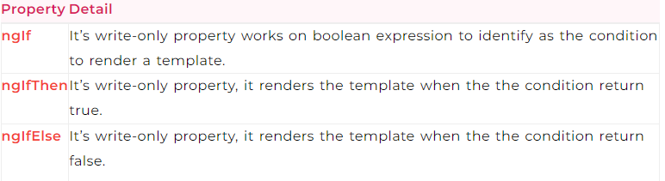
TYPES

Slide 4
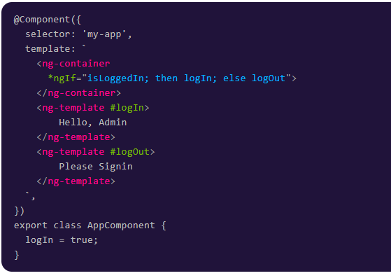

Slide 5
